Slide 1
Previous Work
Zhiyuan Li

Slide 2
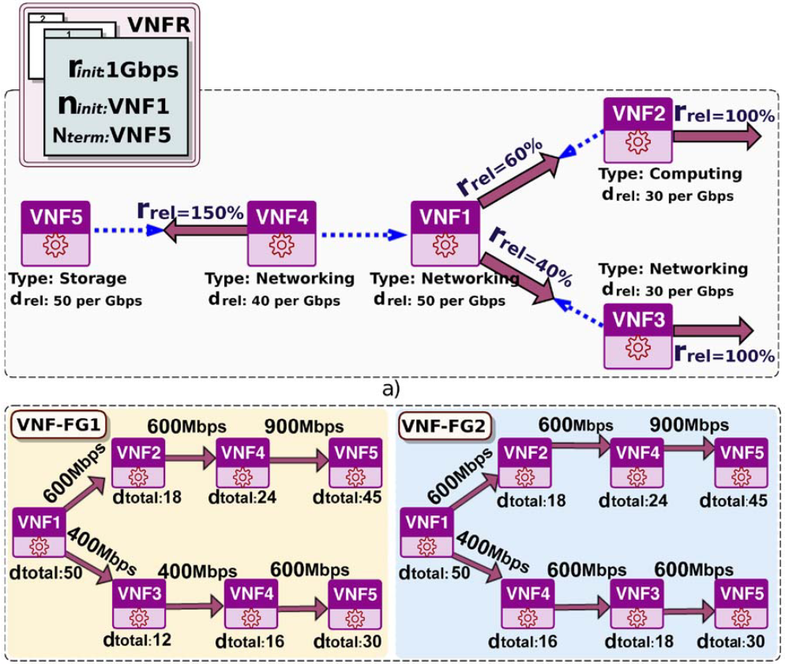
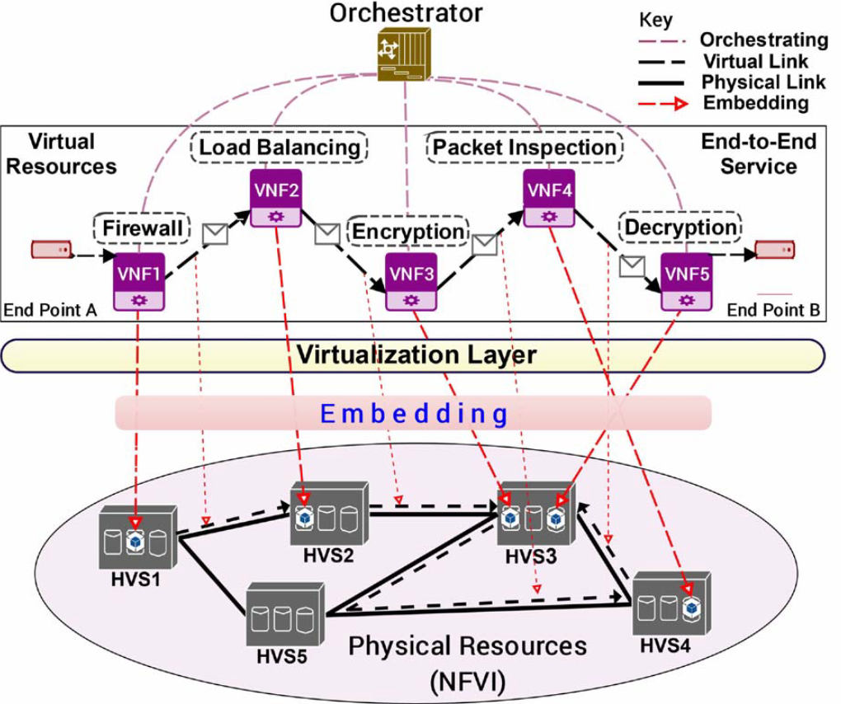
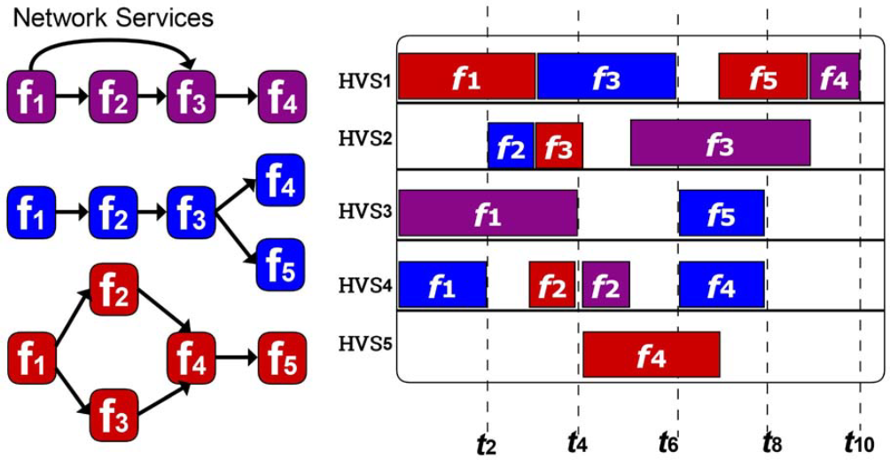
Previous Work
Online Coordinated Resource Allocation via Multi-Agent and Machine Learning in NFV
We propose an NFV online coordinated resource allocation framework (OCRA) that completes the three stages simultaneously in a coordinated way.
VNFs chain composition
VNF forwarding graph embedding
VNFs scheduling
formalize the NFV-RA problem as a Mixed Integer Programming (MIP) model， optimized with deep reinforcement learning
define the action of the RL agent as a topology, which contains node information and link information
Notes:
NFV decouples network functions from dedicated hardware, and implements them in software which is called Virtual Network Functions
Internet Service Providers (ISPs) can improve network resource utilization with significantly reduced capital and operational expenditures.
an important challenge is the resource allocation problem in NFV (NFV-RA), which can be divided into three stages: VNFs chain composition, VNF forwarding graph embedding, and VNFs scheduling.
VNFs Chain Composition (VNFs-CC): In the first stage, VNF Forwarding Graph(VNF-FG) is generated, which describes how traffic traverses an end-to-end SFCR through its VNFs;0
VNF Forwarding Graph Embedding (VNF-FGE): The resulting graph (VNF-FG) of the first stage is the input of this stage, which aims to allocate VNF-FGs in the network infrastructure appropriately, considering a set of SFCRs; and
VNFs Scheduling (VNFs-SCH): Each network function is executed to minimize the total execution time without degrading the service performance and to satisfy all the dependencies among the VNFs that make up the SFCR.

Slide 3
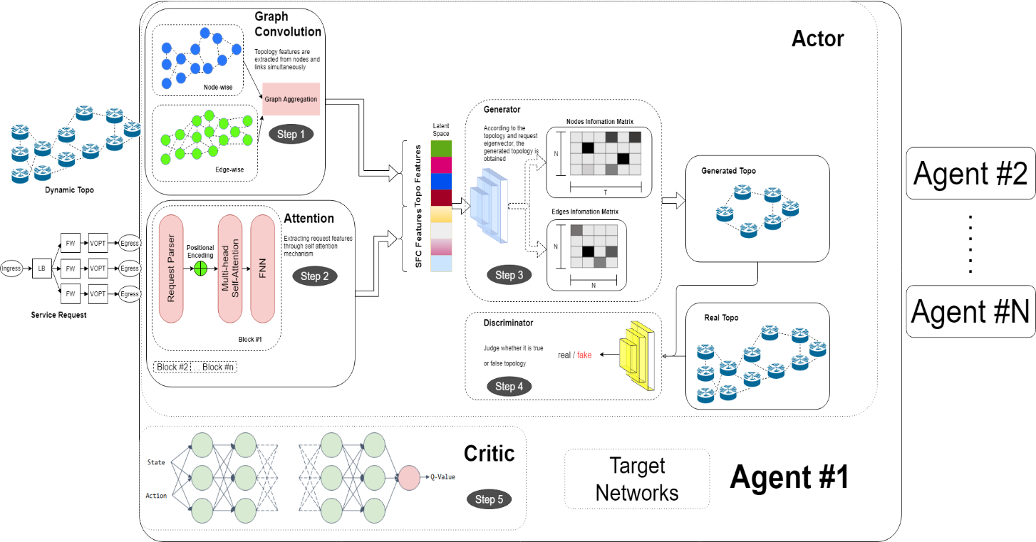
Previous Work
Framework：OCRA
Parallel Multi-Agent Training；
Bicomponent GCN - Dynamic Topology Feature Extraction ；
Self-attention - Request Feature Extraction
GAN Generates Subgraph；
Dynamic Topology Feature Extraction: Spatial features of irregular network topologies are key information in the NFV-RA problem。
Notes:
Spatial features of irregular network topologies are key information in the NFV-RA problem. We therefore use an improved GCN to manage the automatic spatial feature extraction on the network topology
interaction between network links is ignored. Inspired by [26], we build a link-wise graph to model the correlation between links and form a bicomponent GCN with the node-wise graph to combine the information of nodes and links. We define three types of link interaction patterns to construct the link-wise graph:

Slide 4
Previous Work
Framework：OCRA
Parallel Multi-Agent Training；
Bicomponent GCN - Dynamic Topology Feature Extraction ；
Self-attention - Request Feature Extraction
GAN Generates Subgraph；
Request Feature Extraction: we use the self-attention mechanism to draw global dependencies between VNFRs in SFCRs and to calculate the representation of SFCRs
Notes:
Previous work constructs VNFFGs based on heuristic algorithms with fixed rules while ignoring extracting features from this relationship

Slide 5
Previous Work
Framework：OCRA
Parallel Multi-Agent Training；
Bicomponent GCN - Dynamic Topology Feature Extraction ；
Self-attention - Request Feature Extraction
GAN - Generates Subgraph；
Generates Subgraph: The action generated by the agent is a subgraph, and we use a GAN to directly manipulate graph structure data.
Notes:
the generator takes samples from a priori distribution (i.e. a real subgraph set of the network topology) and generates two matrices representing the node information and link information.
The combination of the two matrices 7 represents a subgraph G0 n of the network topology. The discriminator classifies whether the subgraph comes from the real subgraph dataset or the generator.

Slide 6
Previous Work
Framework：OCRA
Parallel Multi-Agent Training；
Bicomponent GCN - Dynamic Topology Feature Extraction ；
Self-attention - Request Feature Extraction
GAN - Generates Subgraph；
Imitation Learning：heuristic solutions can guide the training process in addition to letting the agent blindly explore actions
Notes:
With the help of demonstrations given by an expert, imitation learning can quickly match the state-action trajectory [24] distribution generated by the agent with the input expert trajectory distribution

Slide 7
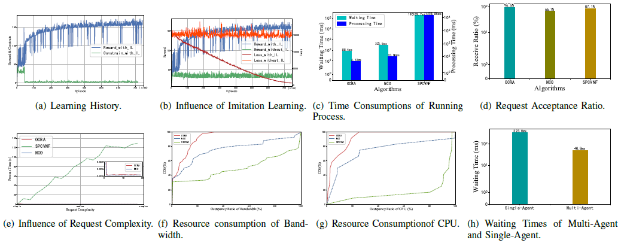
Previous Work
EVALUATION：
Results
Notes:
Training Process
Influence of Imitation Learning
Time Consumptions
Request Acceptance Ratio
Influence of Request Complexity

Slide 8
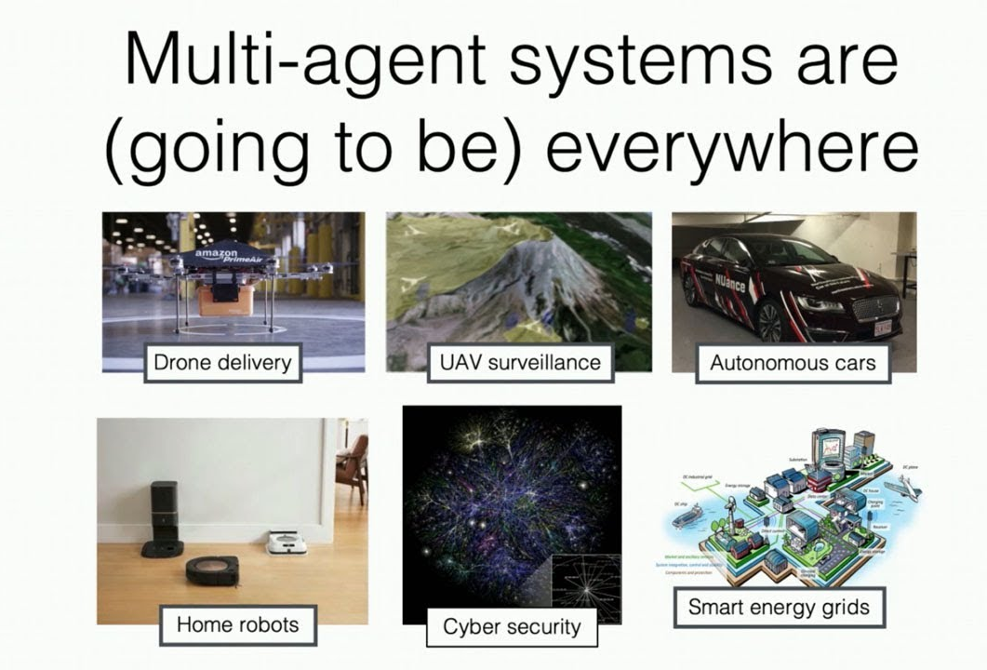
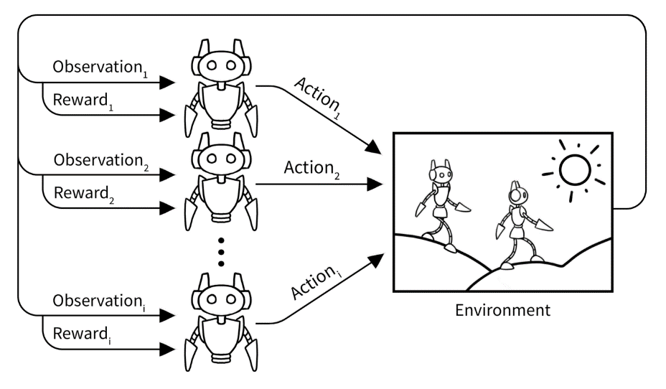
Previous Work
Coordination as Inference in Multi-Agent Reinforcement Learning
The cooperative model that most closely resembles the way humans cooperate in nature is fully decentralized
Centralized Training and Decentralized Execution (CTDE) may fail due to the issue of Centralized-Decentralized Mismatch (CDM).
We propose an inference-based coordinated MARL method - individual intention modeling; attention mechanism and causal inference-based agent-level coordination
Notes:
Despite the fact that the Centralized Training and Decentralized Execution (CTDE) paradigm has gained much attention due to its superior performance in the field of cooperative Multi-Agent Reinforcement Learning (MARL), fully decentralized policies learned using centralized training may fail due to the issue of Centralized-Decentralized Mismatch (CDM).
the suboptimality of one agent’s policy can propagate through the centralized joint critic and negatively affect policy learning of other agents, causing catastrophic miscoordination, which we call centralized-decentralized mismatch (CDM).
The IL paradigm, however, performs poorly even in simple cooperative tasks. One major issue that hinders agents from coordinating their own actions with those of others is that they are unaware of the presence of other agents, which means that they are unable to adapt their policies to the actions of other agents.
During interpersonal action coordination, people use their own motor system to simulate other people’s actions in order to make predictions [8]. This allows them to evaluate others’ intentions or motivations associated with higher-level, meta-representational thinking and to make decisions accordingly in social contexts, leading to the development of a cooperative relationship. In fact, humans are adept and instinctive at making inferences from others’ external behavioral signals in order to deduce additional meanings behind the behavior.

Slide 9
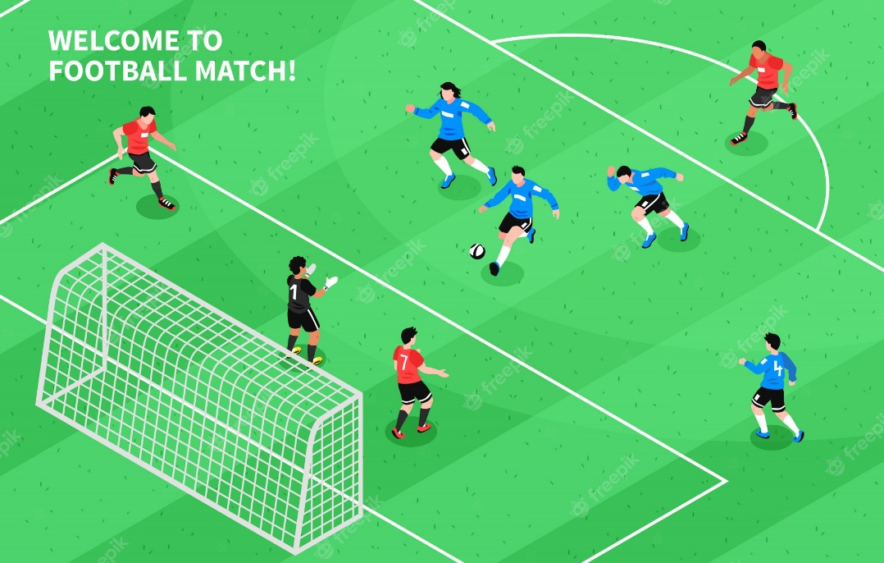
Previous Work
Coordination as Inference in Multi-Agent Reinforcement Learning
Interpersonal action coordination - motor system
Make decisions accordingly in social contexts
Deduce additional meanings behind the behavior
Notes:
During interpersonal action coordination, people use their own motor system to simulate other people’s actions in order to make predictions [8]. This allows them to evaluate others’ intentions or motivations associated with higher-level, meta-representational thinking and to make decisions accordingly in social contexts, leading to the development of a cooperative relationship. In fact, humans are adept and instinctive at making inferences from others’ external behavioral signals in order to deduce additional meanings behind the behavior.
Imagine a team of players in a football match. Each player needs to predict his or her partner’s movements in addition to reacting to each other’s movements in order to cooperate correctly and effectively. In addition, the whole team must share common macro-goals and macro-intentions in order to effectively accomplish the joint action.

Slide 10
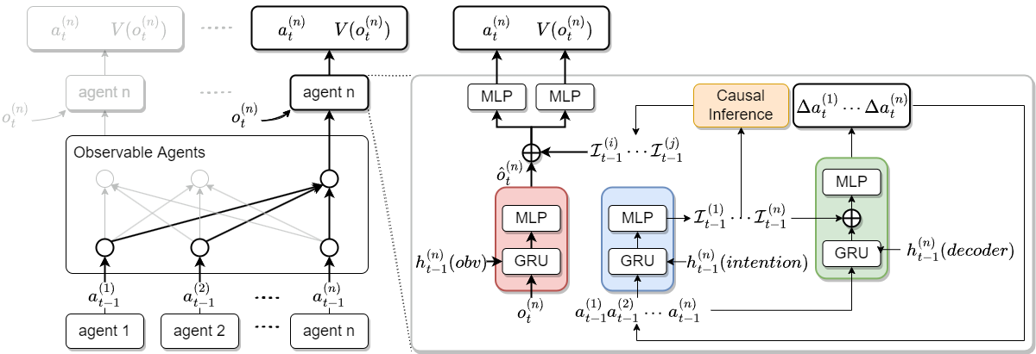
Previous Work
Framework：Deep Motor System
In order to understand others’ action, the perceivers must first observe the action, then form a mental imitation of it, and make a comparison between the observed and imitated action through the mirror neural system.
In addition to understanding the behavior of others, perceiving agents should also successfully match their own policy with their partners’ by being aware of the causal effects of others’ intentions on their policy
Notes:
To exploit this paradigm in cooperative multi-agent settings, we first propose a novel Deep Motor System (DMS) framework to encode the information (intention) contained in the observed actions, i.e., the fact that an agent decides to perform a specific action rather than another, which is crucial for learning efficient policies.
Secondly, not every agent can provide useful information, and redundant information may even impair collaboration. Inspired by Causal Inference (CI), we believe that agents need to have beliefs about who to coordinate with; in other words, they are more inclined to cooperate with those who are potentially exerting more influence on their policies. Specifically, the intentions of other agents that lead to drastic changes in the agent’s policy are considered relevant and are fed to the agent’s policy network and value network.
CI can be viewed as the (hard) attention mechanism, widely used in many AI fields [10][11], as it selects a subset from other agents’ intentions, entirely discarding the others. However, the hard-attention mechanism is nondifferentiable.
Therefore, it cannot learn the causal inference threshold directly through end-to-end back-propagation. Thus, we also introduce a soft-attention mechanism to calculate the importance distribution of other agents’ intentions and generate “soft” filtered intentions. The filtered intentions can improve the agent’s environment model as it may provide the agent with information about the parts of the state space that has not yet been accessed. This information can also be utilized to make agents explore the most promising region in the state space, reducing the exploration cost and significantly accelerating the convergence. Most importantly, the iterative reasoning and policy improvement among agents will continuously encourage cooperation

Slide 11
Thanks

